Slide 1
Smart Mail Cluster
GROUP 3:
Team Members
1.) Jivites Damodar - CB.SC.U4AIE24020
2.) Kiruthikpranav - CB.SC.U4AIE24023
3.) Usman Shareef - CB.SC.U4AIE24024
4.) Ramkumar K R - CB.SC.U4AIE24042
5.) Sukanthan - CB.SC.U4AIE24056

Slide 2
Application Domain :
The Smart Mail Cluster project belongs to the domain of Enterprise Communication Management Systems and Intelligent Information Retrieval. In modern enterprises, email remains one of the most dominant forms of communication, often leading to massive volumes of unstructured data that are difficult to manage manually.
This system primarily focuses on improving information management, productivity, and collaboration in organizations that handle large-scale communication data.

Slide 3
Data structure DETAILS
DATA STRUCTURE | WHY CHOOSEN
Directed Weighted Graph(User Graph) | Captures user-to-user communication patterns and frequency. Direction shows sender to receiver, weight shows number of emails exchanged.
Directed Graph(Thread Graph) | Emails form hierarchical conversations with replies and forwards. A directed graph naturally models email flow from parent to child emails
Trie | Stores words from email subjects and content so we can quickly check a word exists in how many emails. Each node keeps email IDs where the word appears, making topic grouping easy.
Disjoint Set / Union-Find | Combines emails that belong to same or related topics efficiently.
Hash map | Large email datasets require instant access. Allows retrieval by ID in constant time.

Slide 4
Operations & Time Complexities
SEND EMAIL
Creates a new email in the system.
Adds a directed edge in the user graph from sender to receiver.
Stores the email in emailStore for quick lookup.
Time complexity-O(n)
REPLY EMAIL
Sends a reply to an existing email.
Adds a directed edge in the user graph
Creates a new Reply Edge in the thread graph connected to the original email.
Stores the email in emailStore for quick lookup.
Time complexity-O(n)

Slide 5
ForwardEmail
Forwards an existing email to another user.
Adds a directed edge in the user graph.
Creates a new forwarded node in the thread graph
Stores the email in emailStore for quick lookup.
Time complexity-O(n)
View Thread
Displays all emails in a conversation thread starting from a given email.
Traverses the thread graph to show replies and forwards in proper order.
BFS to traverse the thread graph
Time complexity-O(V+E)
VIEW CLUSTER
Displays groups of related emails based on shared keywords in the subject and body.
Helps users see which emails belong to the same topic or discussion.
View Cluster shows groups of emails with similar content using Trie and Disjoint Set, making topic-based grouping fast and scalable.
Time complexity-O(E∗T∗L+W∗E^2), E = number of emails, T = maximum tokens per email, L = maximum length of a token, W = number of distinct words in the Trie

Slide 6
BFS ALGORITHM
BFS is a graph traversal algorithm that explores nodes level by level, starting from a given node.
It uses a queue to keep track of nodes to visit next
1.) Start from the root email of a thread (original email).
2.)Enqueue the root and mark it as visited
3.)Repeatedly:
Dequeue a node (email)
Process it (view content)
Enqueue all unvisited children (replies/forwards)
Ensures emails are displayed in the correct conversation order.
Efficient for traversing thread graphs, which can have multiple replies and forwards.
Guarantees all connected emails in a thread are visited once.
Time Complexity:
O(V + E)
V = number of emails in the thread
E = number of reply/forward edges

Slide 7
Performance Table
Input size | Send Email (ms) | Reply Email (ms) | Forward Email (ms) | View Thread (ms) | Clustering (ms)
10000 | 0.000205 | 0.000104 | 0.000100 | 0.000090 | 0.079543
20000 | 0.000149 | 0.000099 | 0.000100 | 0.000050 | 0.163023
30000 | 0.000200 | 0.000099 | 0.000066 | 0.000033 | 0.256761
40000 | 0.000175 | 0.000100 | 0.000075 | 0.000014 | 0.361385
50000 | 0.000190 | 0.000099 | 0.000060 | 0.000020 | 0.486096

Slide 8
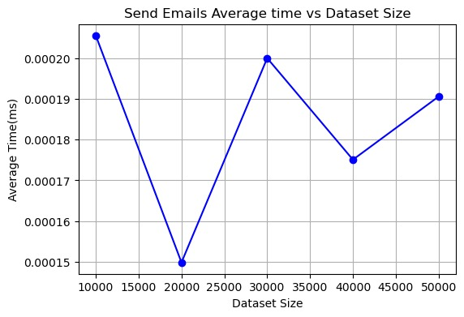
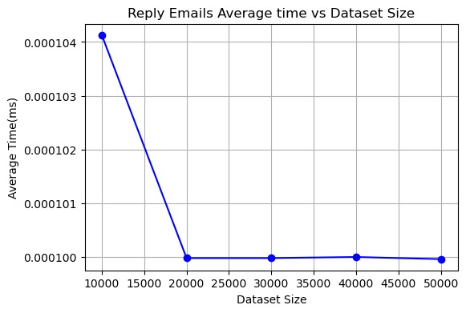
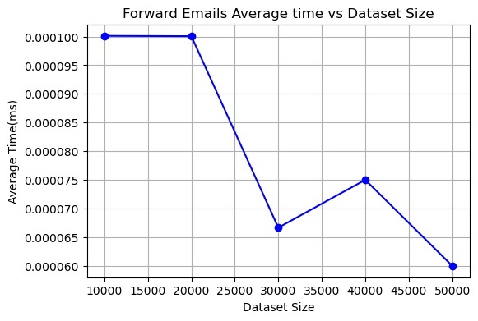
Time Complexity

Slide 9
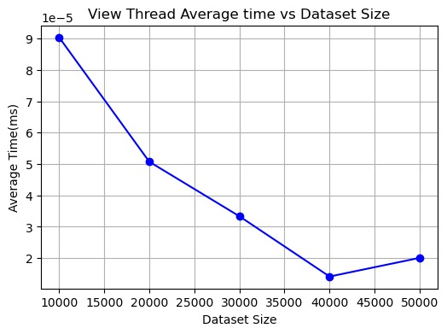
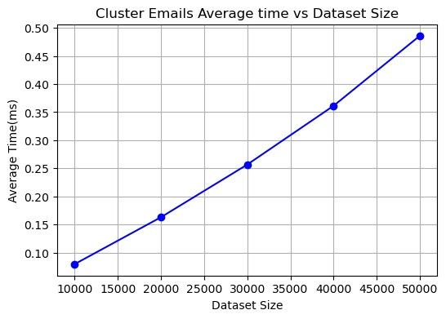
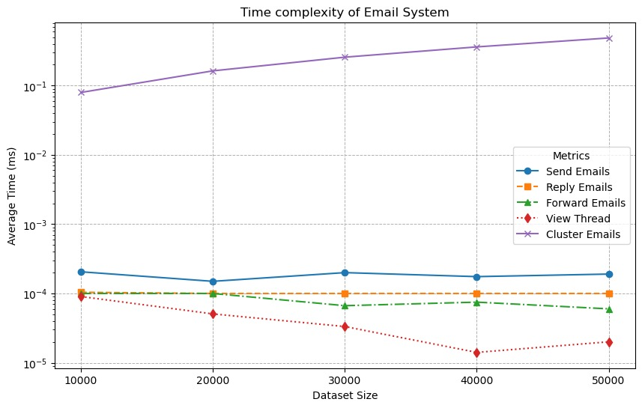
Time COMPLEXity

Slide 10
ADVANTAGES
Efficient Threading: Directed graphs + BFS allow viewing full email threads in proper order.
Topic-Based Clustering: Trie + Disjoint Set group emails by similar keywords quickly.
Fast Lookup: HashMap (EmailStore) enables instant retrieval of emails by ID.
Interaction Awareness: Weighted edges in user graph capture email frequency between users.
Scalable Clustering: Union-Find handles dynamic merging of emails into clusters efficiently.
DISADVANTAGES
High memory usage for large email datasets (Trie).
Worst-case operations can be slower for dense graphs or sparse Tries.
BFS traversal requires extra memory for queue and visited set in very large threads
Trie may be inefficient if emails contain many unique words.

